Slide 1
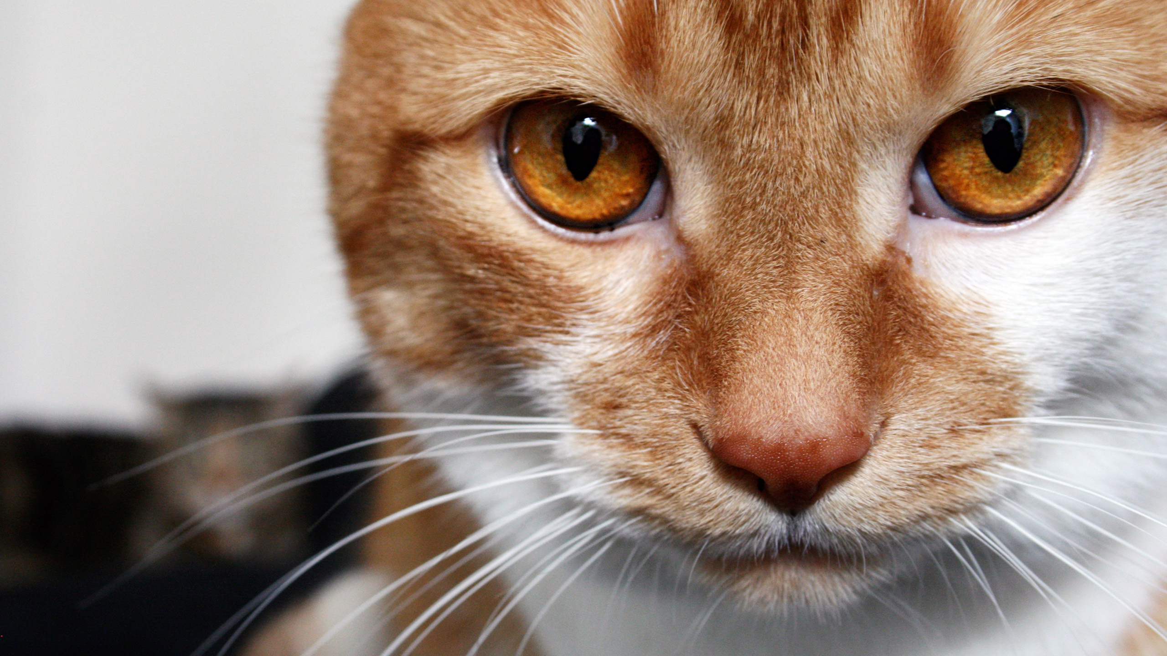
Project “Kocour”
R2D2 team

Slide 2
Main Idea

Slide 3
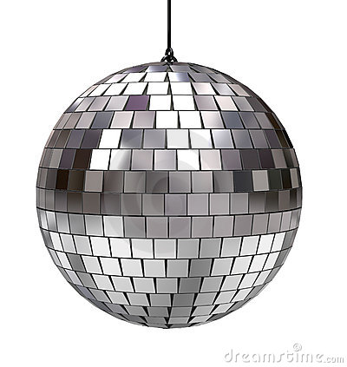
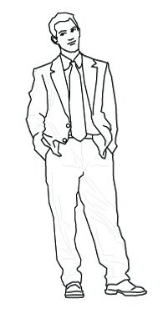
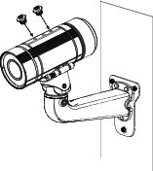
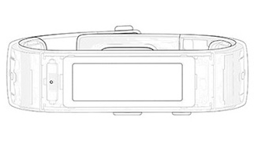
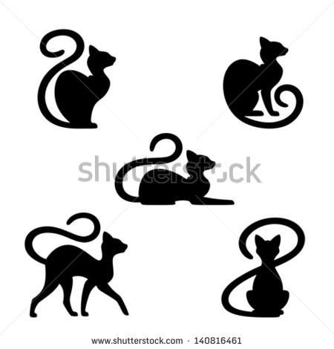
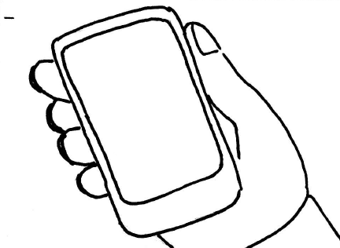
How it works
Cat in the room!
Cat in the room! Feel good, temp is ok!
Photo

Slide 4
Architecture

Slide 5







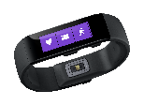




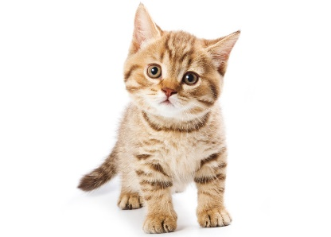
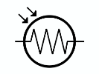

Service Architecture
Azure Table
Azure Web API
Azure Web Job
Azure Blob
UWP
IoT Hub

Slide 6
Demo

Slide 7
Cat happy!
You happy!
r2d2@kocour.com

